Slide 1
Fundamentals of Scientific Computing
– AND –
Applied Bioinformatics and Computational Biology
Fall 2020

Slide 2
A1.aa
Course Intro
Sabah Ul-Hasan Credit: Andrew Su

Slide 3
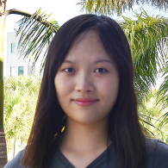
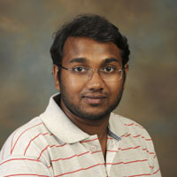
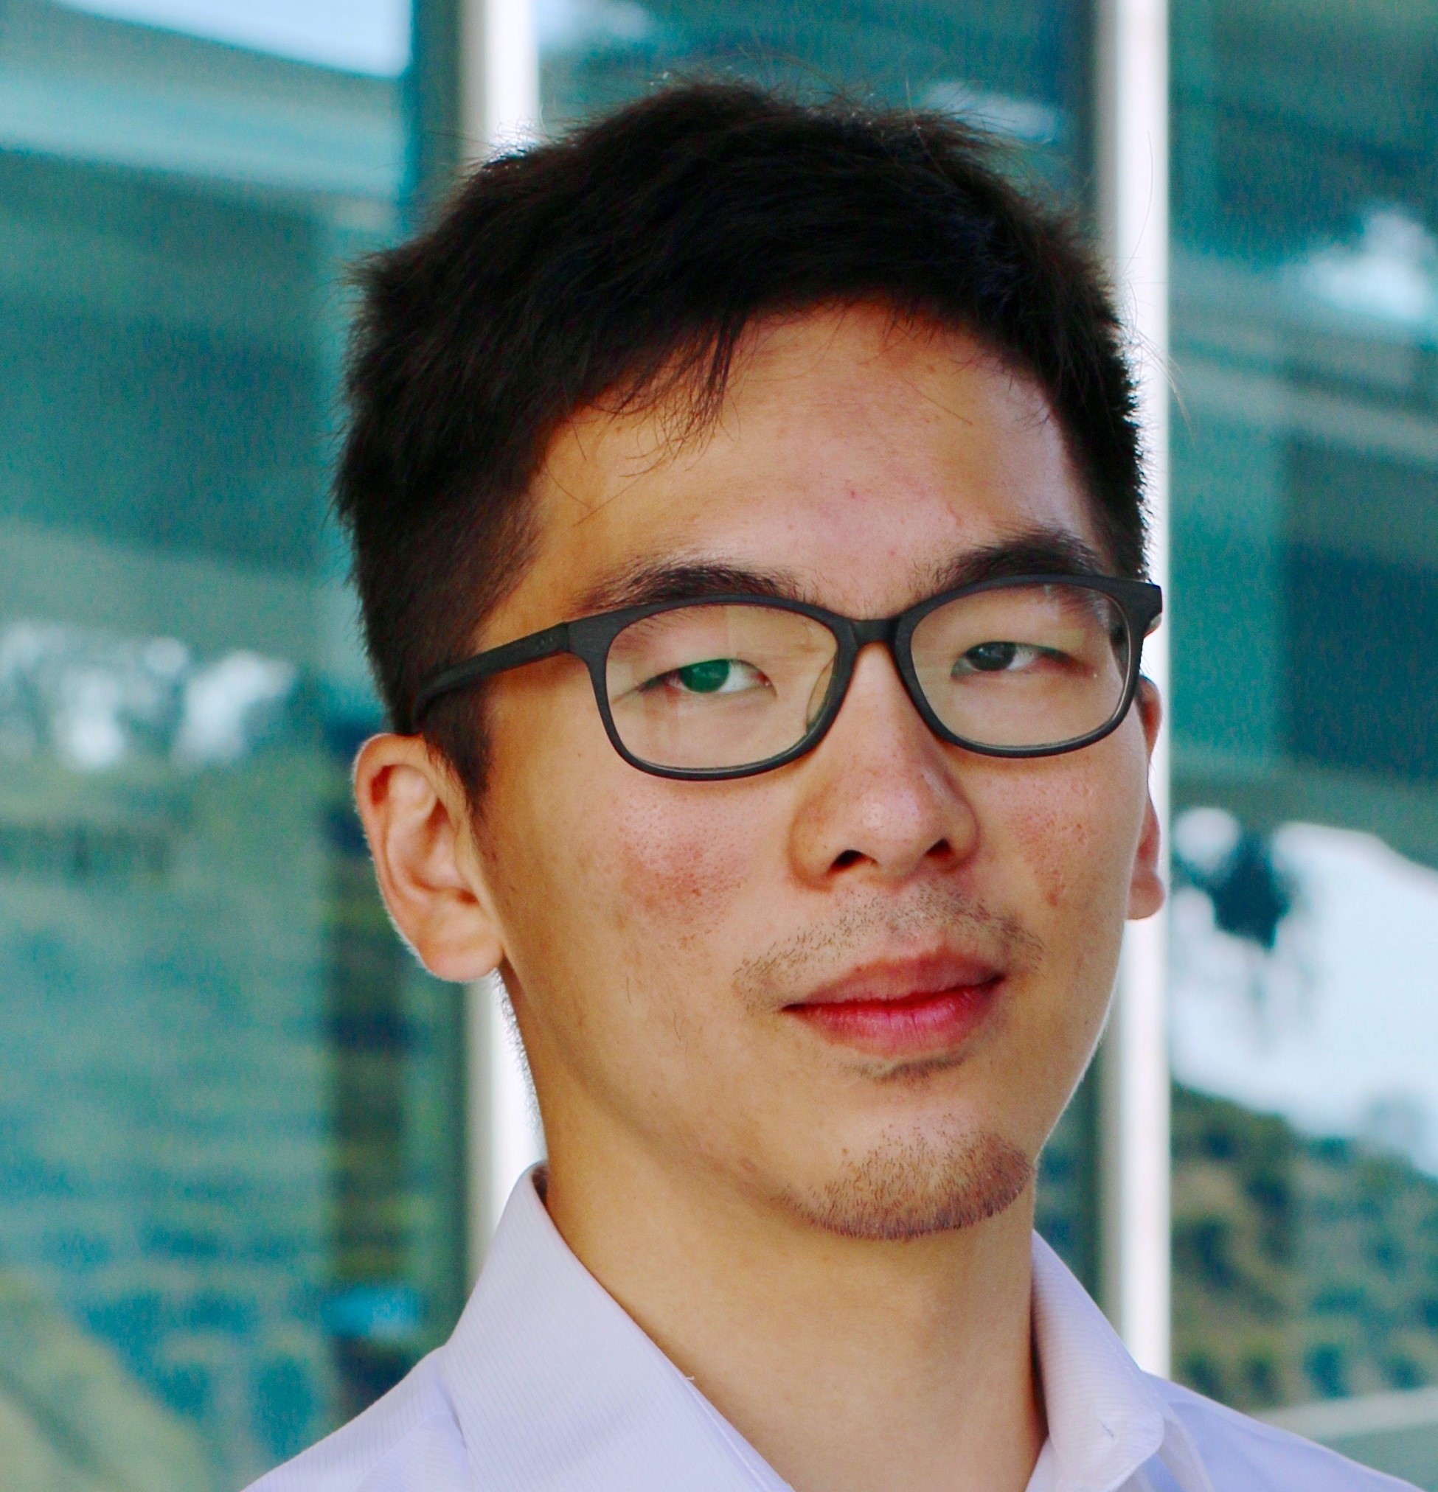
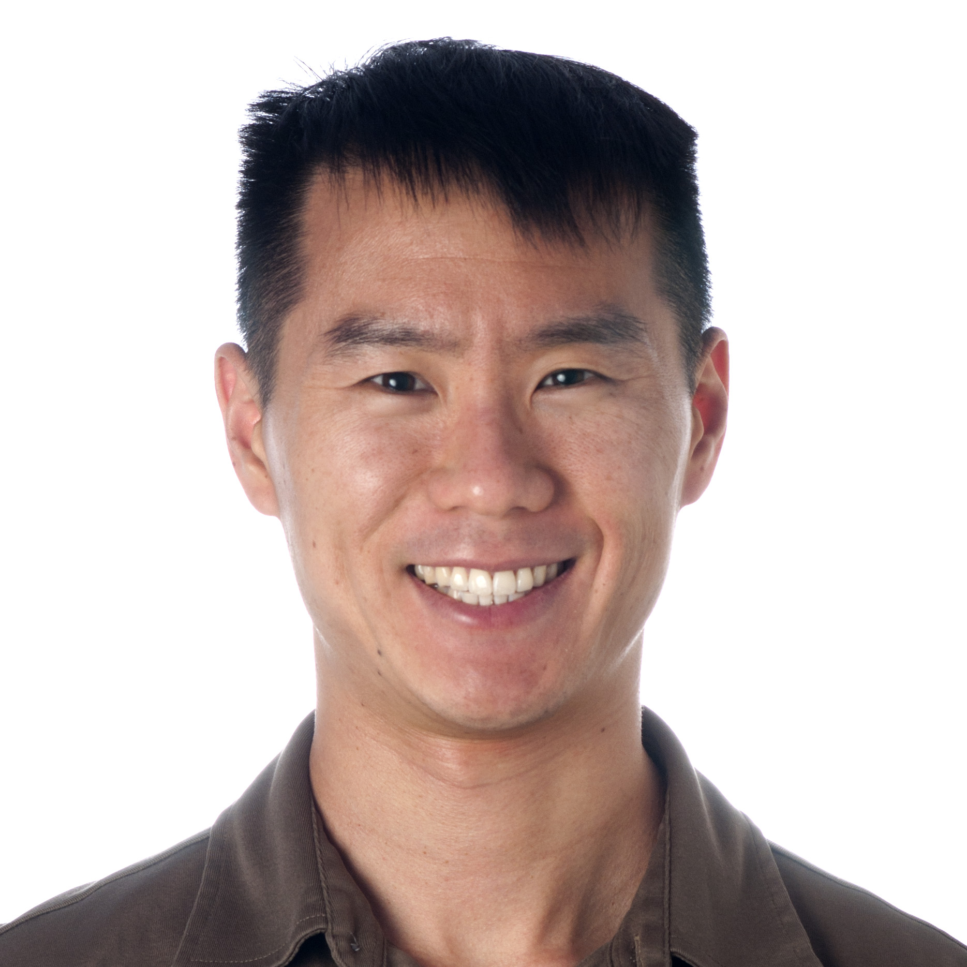
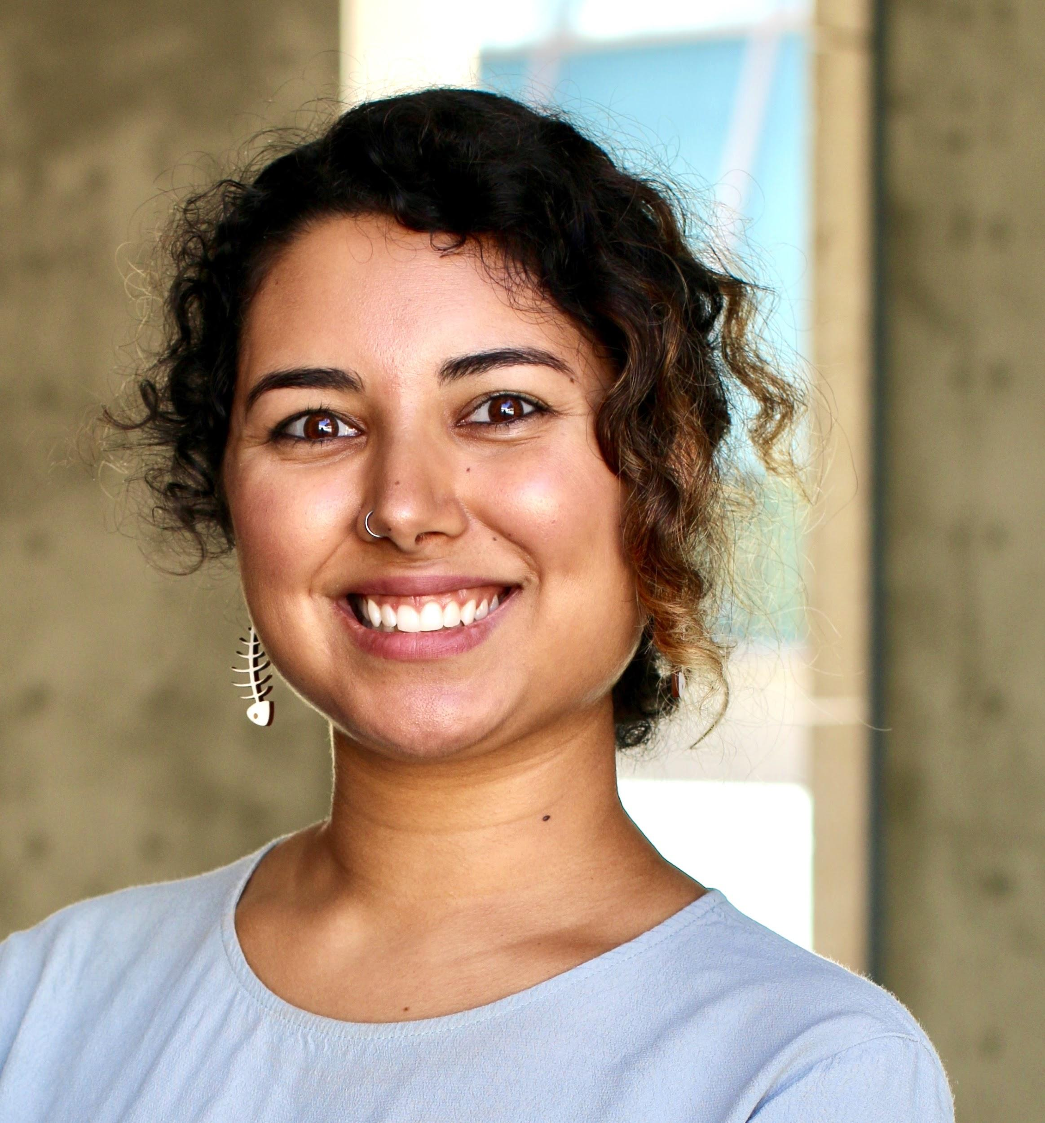
Brief Introductions (30 sec each)
TAs
Course Directors
Huitian Dao
Karthik Gangavarapu
Shang-Fu
Chen
Andrew Su
Sabah Ul-Hasan

Slide 4
What to Expect From Us
Expertise
Mentorship
Professionalism
Communicative
Huitian Dao
Karthik Gangavarapu
Shang-Fu
Chen
Andrew Su
Sabah Ul-Hasan

Slide 5
It’s a Pandemic, Afterall
Expertise
Mentorship
Professionalism
Communicative
We’re humans, too. That means we’ll likely be decompressing during non-business hours (especially weekends!)
Support of you being your healthiest self
Huitian Dao
Karthik Gangavarapu
Shang-Fu
Chen
Andrew Su
Sabah Ul-Hasan

Slide 6
ABCB Course Structure
https://github.com/SuLab/Applied-Bioinformatics/tree/Fall-2020
Layout: 45 x 45, homeworks are due each Tuesday at 8 AM PST
Fundamentals of Scientific Computing (Unit A, ~4 weeks)
Weeks 1-2 Bash, Juypter and git
Weeks 3-5 R
Applied Bioinformatics and Computational Biology (Units B-C, ~8 weeks)
Weeks 5-9 RNA-seq
Weeks 9-12 Capstone Project (tying it all together)

Slide 7
Course Philosophy

Slide 8
Imagine this as all of bioinformatics

Slide 9

Imagine this as all of bioinformatics
Provide a broad overview of all topics in bioinformatics?

Slide 10
Imagine this as all of bioinformatics
Provide a broad overview of all topics in bioinformatics?
Cover a selection of bioinformatics topics in great depth?

Slide 11



Imagine this as all of bioinformatics
Provide a broad overview of all topics in bioinformatics?
Cover a selection of bioinformatics topics in great depth?
Provide guidance and confidence in your ability to manage and analyze your own data
YOU TODAY

Slide 12
Course Philosophy
This course is not a comprehensive review of bioinformatics
This course is a course to learn applied skills, using a few common bioinformatics analyses as examples
There are many ways to cook an egg We will demonstrate one way

Slide 13
Learning Objectives
Technical
bash – command line shell
jupyter – analysis notebooks
git and github – version control
R – language for statistical computing
bioconductor – R libraries for bioinformatics
Scientific
RNA-seq
Reproducibility
Presentation and Peer Review
NOT covering image analysis, phylogenetics, genetic association, biostatistics, cytoscape, biomedical ontologies, algorithms, ...

Slide 14
Grading
Fundamentals (Unit A): 50 pts
Participation (20 pts): Zoom and Slack
Homework (3 x 10 pts): Due each Tuesday @ 8 AM PST
Applied Bioinfo (Units B-C): 100 pts
Participation (20 pts): Zoom and Slack
Homework (5 x 10 pts): Due each Tuesday @ 8 AM PST
Capstone (30 pts): 15 pts for content, 10 for presentation, 5 for peer review

Slide 15
Utilizing Zoom for Participation (Test)
👍
✋
I’m not understanding and need clarification
I understand this

Slide 16
Utilizing Zoom for Participation (Test)
It’s our job to make sure everyone is on the same page, and this is a no-judgement zone. Always ask questions (even the ones that seem ‘dumb’). It’s very likely someone has the same question as you!
👍
✋
I’m not understanding and need clarification
I understand this

Slide 17
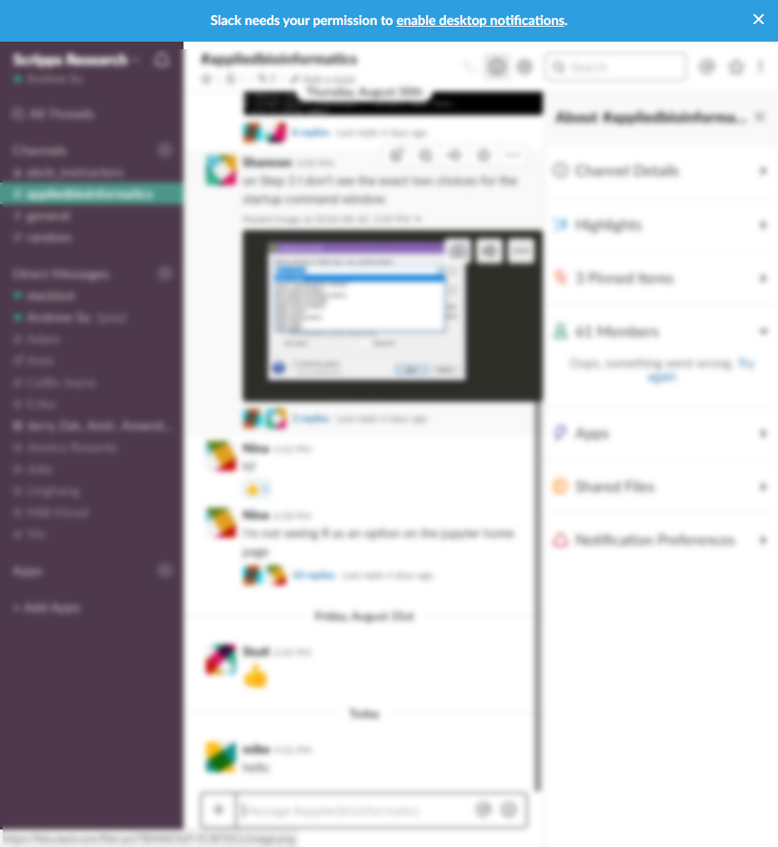
Utilizing Slack for Questions (> Zoom)
https://slack.com/download
Pinned posts = of importance
Reduce chat clutter. If you see a topic/question similar to yours, reply to it as a thread > reply in the main chat
Write your question(s) as one full set > multiple entries after another to reduce notifications

Slide 18
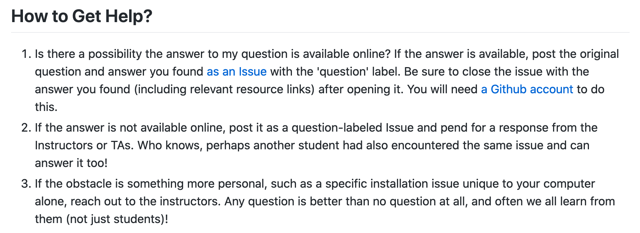
Utilizing Github, Slack (quick questions), and email

Slide 19
Academic Integrity
Reasonable
Discussing assignments and course material
Helping a classmate find a bug in their code
Showing your program to a classmate to help you find a problem in your code
Using online resources to solve assignments, so long as they're not solutions to the assigned problems
Whiteboarding solutions to assignments with others using diagrams or pseudocode but not actual code
Unreasonable
Viewing a classmate's solution in order to solve your assignment
Giving your assignment solution to another student
Starting with someone else's code and making changes to personalize it
Submitting work from a previous course/project as your final project

Slide 20
This class strives to maintain a welcoming environment for learners of all levels and backgrounds
Notes:
Want to know if you encounter unwelcoming behavior outside or inside classroom

Slide 21
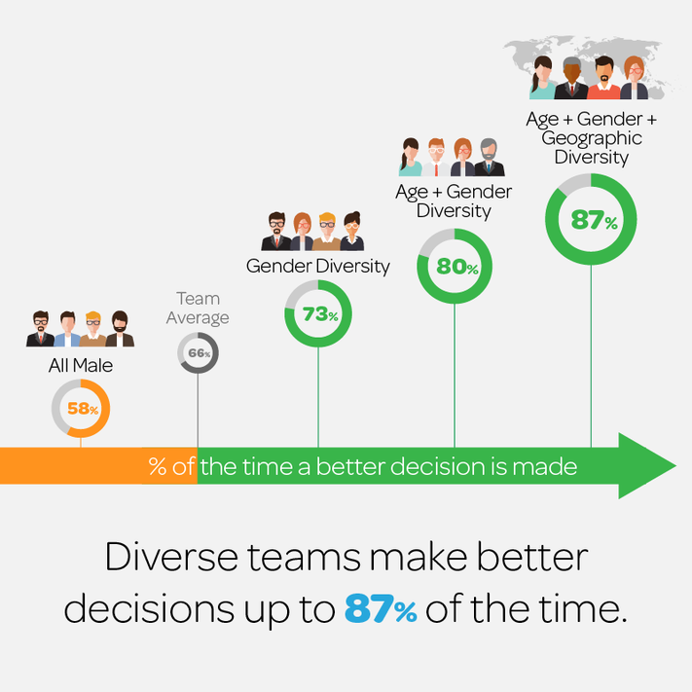
Infographic Credit
Forbes
Diversity in STEM: What It Is and Why It Matters Dr. Kenneth Gibbs (NIH) Scientific American article
Diversity is critical to excellence
Lack of diversity represents a loss of talent
Enhancing diversity is key to long-term economic growth and global competitiveness

Slide 22
Infographic Credit
Forbes
Diversity in STEM: What It Is and Why It Matters Dr. Kenneth Gibbs (NIH) Scientific American article
Diversity is critical to excellence
Lack of diversity represents a loss of talent
Enhancing diversity is key to long-term economic growth and global competitiveness
Questions to be asking yourself during this course 1. Am I being honest with my own biases, which will also benefit my ability to identify biases in the data? 2. Am I being open-minded to different perspectives, giving space for others to share the discussion? 3. What are ways I can be more directly inclusive in how I conduct my science today and going forward?

Slide 23
See something? Say something.
It’s our job create a conducive learning environment for you, and doing so benefits everyone (including us)
Notes:
Want to know if you encounter unwelcoming behavior outside or inside classroom

Slide 24
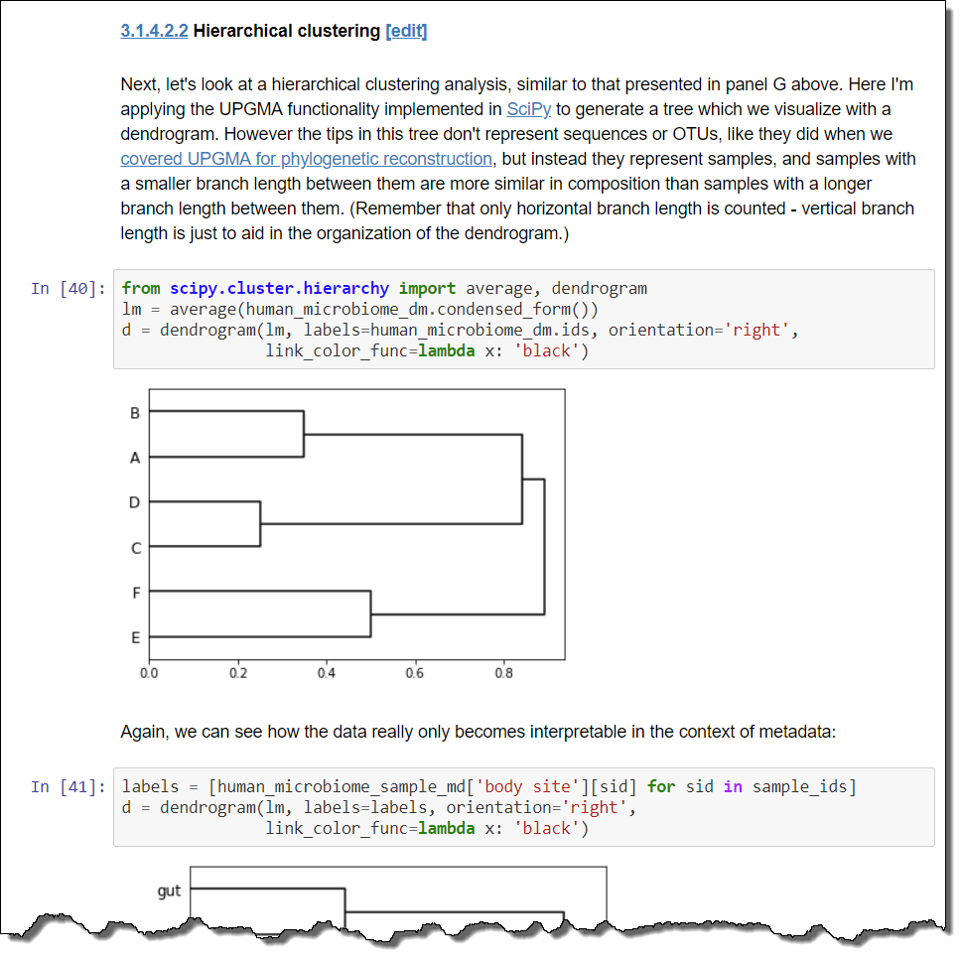
Why Jupyter?
Documentation
+
Code
+
Output
in an executable format
example from: http://readiab.org/book/latest/3/1.html#4.2.2

Slide 25
The (primary) States of Jupyter
Edit mode
(click in edit area)
Code cells
Command mode
(click out of edit area)
Markdown cells
Rendered mode
(control/shift/alt-enter)
Practice using Jupyter Keyboard Shortcuts

Slide 26
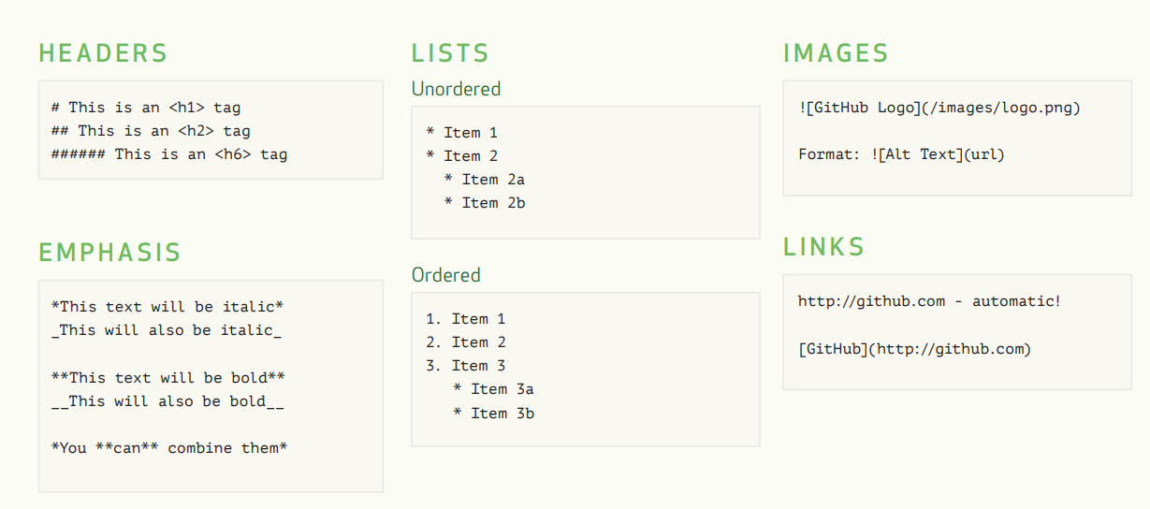
Markdown Cells
Full Docs: https://jupyter-notebook.readthedocs.io/en/stable/examples/Notebook/Working%20With%20Markdown%20Cells.html
Excerpt from https://guides.github.com/pdfs/markdown-cheatsheet-online.pdf

Slide 27
Demo Time every time you see this color slide, it means we’re switching over to Hands-on exercises

Slide 28
Let’s try it!
[ ] Access HW 1 (in nbgrader) [ ] Complete A1.aa tasks on your own
[ ] Confirm you’ve turned on ‘watch releases’ for our 2020 repo
[ ] Enable Slack, access abcb-2020 and reply to intro cue thread
[ ] Enable Canvas notifications, post same sentence in forum

Slide 29
A1.ab
Bash Basics
Andrew Su Credit: Huitian Dao and Sabah Ul-Hasan

Slide 30
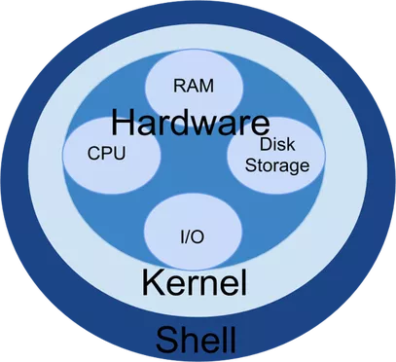
Concepts
Shell is a user interface for access to an operating system's services
Bash is a popular shell for Unix/Linux systems
A command-line interface (CLI) is how users control a system with commands (via text)
In contrast, a graphical user interface (GUI) provides user control using graphical icons
Advanced: Why All Developers Should Learn Command Line

Slide 31
Launching a Shell Through a Terminal
On a Mac, spotlight search for “terminal”
On Windows 10, windows search for “ubuntu” or launch cmder
asu@LAPTOP-LBU6JGIM:~/Applied-Bioinformatics$
username
Computer name
Current directory
Advanced: How to Customize (and Colorize) Your Bash Prompt

Slide 32
Structure of A Command (Demo for 3 min)
[command] [options] [arguments]
$ cat -n test.fasta
$ ls -l *.txt
$ grep -c ‘^>’ test.fasta
$ gzip -cd gene_info.gz

Slide 33
Your First Five Commands
cd – change directory
ls – list directory contents
pwd – print working directory
less – examine file contents
grep – search file contents

Slide 34
More on Bash Scripting (quick references)
Mac terminal cheatsheet (applies to most terminal programs)
Bash cheatsheet
Less navigation cheatsheet

Slide 35
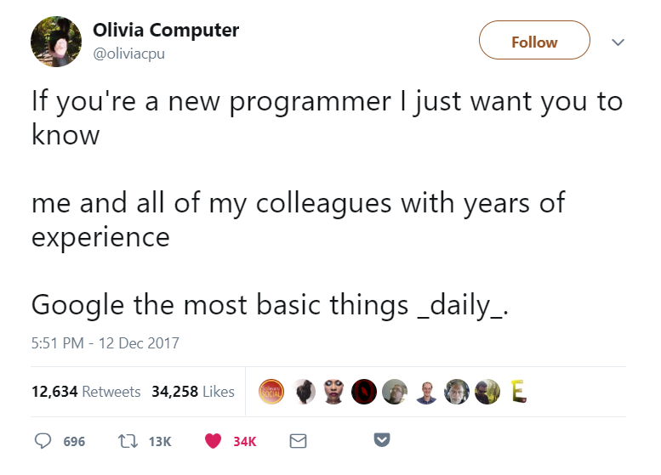
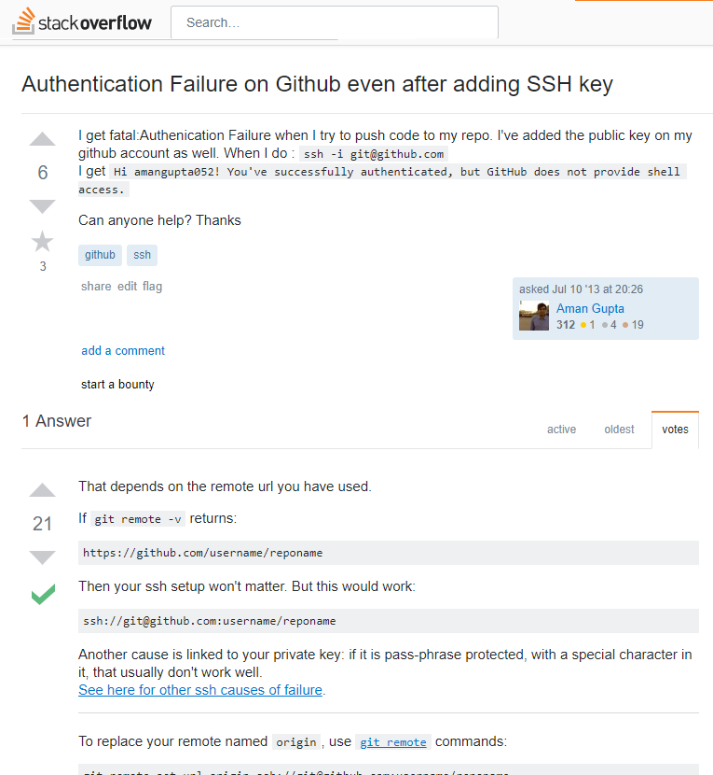
Where to get help?
Using the --help option in terminal
e.g., ls --help
Using the man pages (“manual”) in terminal
e.g., man ls
Google
e.g., ls sort by recently modified
Common useful sites: Stack Overflow, Stack Exchange
Slack and Github Issues

Slide 36
How to ask for help?
Reduce the complexity of the problem to the minimum required to reproduce the error
Post the code necessary to produce the error and all error messages
Describe the process you’ve carried out to solve the problem yourself
Describe your computing environment (e.g., operating system, software versions)

Slide 37
Let’s try it!
[ ] Complete A1.ab tasks of HW 1 as a think-pair-share [ ] Are you able to execute all five of the basic commands?
[ ] Try the rest on your own prior to Thu, what was helpful vs not?

